Slide 1
Go-To-Market Strategy
Template

Slide 2
GTM Plan Overview

Slide 3
Key Elements of a GTM Strategy and Plan
CURRENT SITUATION: What’s happening in the market that our product can address.
MARKET OPPORTUNITY: The size of the opportunity (revenue, growth rate, etc).
WHAT WE'RE LAUNCHING: What the product does, the benefits for the target audience <Product Brief Template>
MESSAGING STRATEGY:: Positioning, differentiators, key value propositions, benefits <See Messaging Template>
PRICING: How new capabilities, product(s) or service(s) are priced.
ROUTES TO MARKET: How the product is purchased. Direct, partners, channels.
TARGET AUDIENCES: The group of people you’re trying to reach with your message and offer.
MARKETING GOALS: Desired outcomes. Limit to 2-3.
MARKETING STRATEGIES: Your approach to achieve each objective. Limit 3-5.
MARKETING OBJECTIVES: Steps to achieve your strategies. Should be specific and measurable. Limit 2-3.
MARKETING TACTICS: Marketing activities by functional area supporting objective. Ideally a visual depicting a potential buyer’s experience of these activities in market.
TIMING: When key activities will hit the market.
BUDGET: Money needed to support the GTM strategy and plan.
SUCCESS METRICS: How progress will be measured against the objectives and by functional area.
RISKS AND CONSIDERATIONS: Anything that may prevent you from hitting dates or achieving your goals.

Slide 4
GTM Plan Template

Slide 5
Current Situation
What’s happening in the market that created an opportunity for growth addressed by this new product (service or set of new capabilities/features.)
Trend 1
Trend 2
Trend 3

Slide 6
Market Segments
What markets are you targeting for this launch?
Market 1 (For example: Fortune 500 Technology companies based in the US)
Market 2

Slide 7
Market Opportunity
Size the revenue opportunity based on the market you’re targeting
Determine what you can reasonably expect to achieve assuming a successful launch and a 6-12 month on-going marketing campaign.
POTENTIAL MARKET OPPORTUNITY
$1250
What is the total dollar value of the opportunity
$960
TOTAL ADDRESSABLE MARKET
What do you reasonable think you can achieve given your product and competitive environment within the first 6 -12 months of launching.

Slide 8
What’s Launching
Summary of the product or ”What’s New” you’re planning to launch.
What’s launching (product description, or incremental new capabilities)
How does it work?
What are the benefits to the target audience?
What is unique about the product/feature vs. competitors
What are the core use cases
List any known shortcomings

Slide 9
Target Audience
What specific groups of people are we targeting for this release? Include their pains, needs, role, motivations, etc.
Provide as much information as possible.

Slide 10
Messaging Strategy
THE WHY |  | What’s happening in the market that makes it a great time to launch.
BUYER’S PROBLEM |  | What pain points will this product (service or new capabilities) specifically address?
VALUE SOUGHT (THEMES) |  | THEME 1 (e.g.: Accuracy) | THEME 2 (e.g.: Safety) | THEME 3 (e.g.:Simplicity)
BENEFITS |  | [write here] [write here] [write here] | [write here] [write here] [write here] | [write here] [write here] [write here]
CAPABILITIES THAT DELIVER THAT VALUE: DIFFERENTIATORS |  | [write here] [write here] [write here] | [write here] [write here] [write here] | [write here] [write here] [write here]
PROOF POINTS (e.g. Third Party validation what you’re saying is true. Ex: Customer testimonials, case studies, analysts, etc.) |  | [write here] [write here] [write here] | [write here] [write here] [write here] | [write here] [write here] [write here]

Slide 11
Pricing and Packaging
Detail how each new product service or new set of capabilities ispriced.
List any special promotional offers (for example)
Free 30-day trial
Free audit of your current technology stack

Slide 12
Plan on a Page
Executive Summary of Your plan
 | LAUNCH
Goals | Broad outcomes expected.
Target Audience | Market Segment | Who you need to reach, engage and motivate in what context.
Key Strategies | Various approaches to achieve the goal
Key Objectives | What specific, measurable steps you’ll take to achieve each strategy
Key Activities | Tactics to support the objectives tied to a strategy
KPIs | How will success will be measured
Budget Required | The investment required to achieve launch goals
Notes:
This is a high level summary of the details that are in the subsequent slides.

Slide 13
Customer Experience
Summarize the marketing activities the buyer will see as part of this plan
STAGES | BUILD AWARENESS | DRIVE ENGAGEMENT | CONVERT TO PURCHASE
KEY MESSAGE
TARGET AUDIENCE TOUCHPOINTS

Slide 14
Functional Plans
Detailed plans for PR, Communications, Product Marketing, Digital, etc. Whatever tactics are needed to support the of launch
 | LAUNCH
Target Audience | Market Segment | Who you need to reach, engage and motivate in what context.
Key Strategies | Various approaches to achieve the goal
Key Objectives | What specific, measurable steps you’ll take to achieve each strategy
Key Activities | Tactics to support the objectives tied to a strategy
KPIs | How will success will be measured
Budget Required | The investment required to achieve the goals

Slide 15
Map key deliverables by type over time
Timeline
Jan
Feb
March
April
May
June
Always-on
Blog and Social Series
Video Series |  |  | Customer Story
Core Assets
Product Marketing Assets
SEM/Paid Advertising
Blog series; new post every 2 weeks
Customer Story
Customer Story
Customer Story
Case Study
Case Study
Ebook
White Paper | Research Report
Tips, tutorials
Update Pitch Deck for Sales
Product overview video
In-app messaging
Product one-sheet for sales

Slide 16
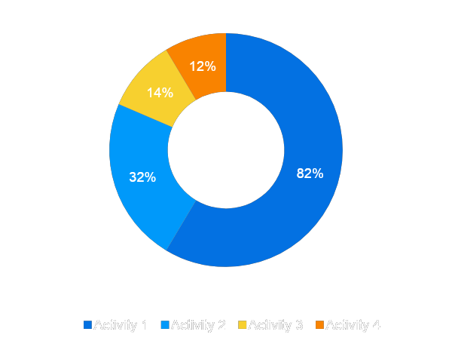
Budget by Mix
% INVESTMENT
MARKETING MIX | BUDGET
PR
Social
Advertising
etc.
TOTAL: $

Slide 17
Success Metrics
Detail you’ll track, measure and analyze to indicate progress and success.
Metrics should be quantitative and tie to the launch goals.
Data point; e.g. $XX revenue within first 6 months
Data point; e.g. XX% of current customers adopting within 3 months
Data point
Notes:
List each objectives and how success will be tracked and measured.

Slide 18
Risks
List any risks and considerations that may impact the launch. For example:
Dates slip for the product release, or functionality must be dropped to hit the date.
Any limitations to the plan based on what was approved/budgeted for.
Any competitor or market factors that could impact the launch.

Slide 19
Enjoy!
Contact info:
Joan Bodensteiner joan@goproperrebel.com

